Slide 1


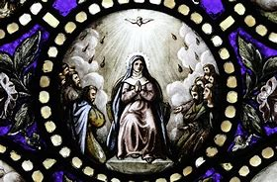
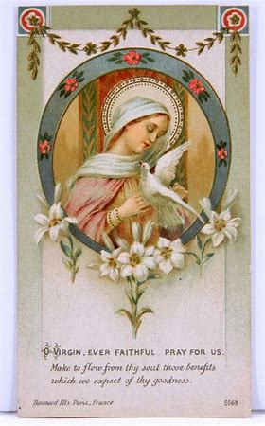

OLV Confirmation Preparation Program
REY 2024-25
September 5, 2024
Katie Sadakierski

Slide 2

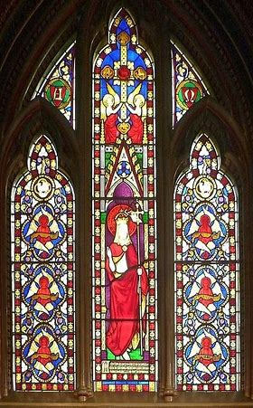
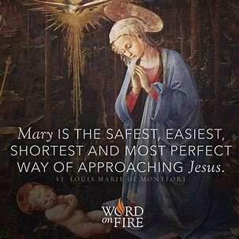
Outline
Opening prayer
Overview of Confirmation preparation program
  Program goals
  Program timeline
  Program resources
Closing prayer
Q & A

Slide 3
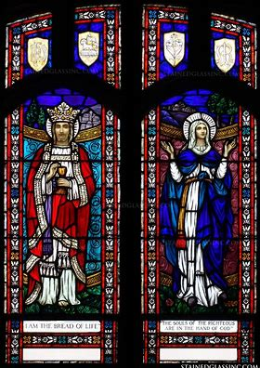
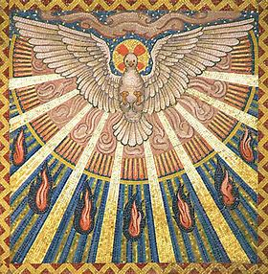
Opening Prayer: Holy Spirit Prayer
Come, Holy Spirit, fill my heart with faith.
Make me your instrument, that I may never be distracted from your purpose, laboring always to build up the Church. Amen.
St. Teresa of Calcutta, pray for us!

Slide 4
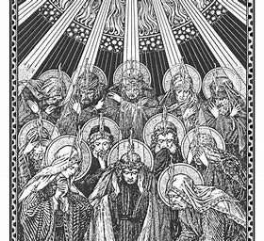
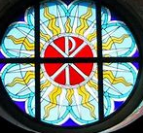
What is the Catholic sacrament of Confirmation?
A personal Pentecost
When you make your Confirmation, you will be:
Completing the sacrament of Holy Baptism
Receiving the Gifts of the Holy Spirit
Confirming your commitment to God

Slide 5
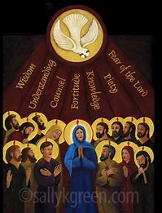
What are the Gifts of the Holy Spirit?
The Gifts of the Holy Spirit we receive are:
  Knowledge
  Fortitude
  Wisdom
  Understanding
  Counsel
  Piety
  Fear of the Lord

Slide 6

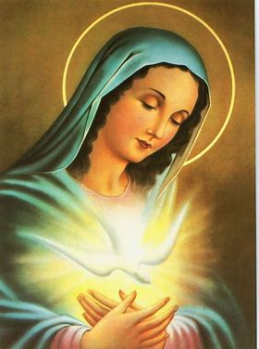
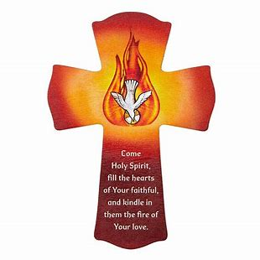
What effects do the Holy Spirit’s Gifts have on us?
The Gifts of the Holy Spirit:
  Strengthen our souls
  Inspire us to use our talents
  Bring us closer to God
  Draw us more deeply into the Church as sons and daughters of God
  Help us to realize what we were made by God for
  Make us holier

Slide 7
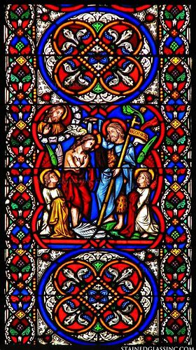
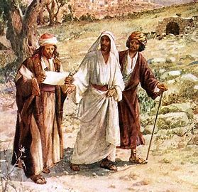
What are the goals of our Confirmation preparation program, and how will we fulfill them?
Discernment
  Vocational fulfillment
  Preparation for spiritual life beyond Confirmation
Growth in friendship with Christ
Spiritual accompaniment

Slide 8
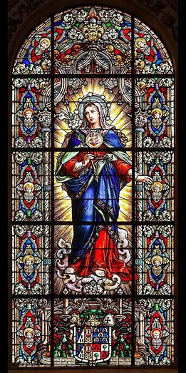

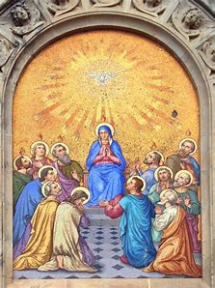
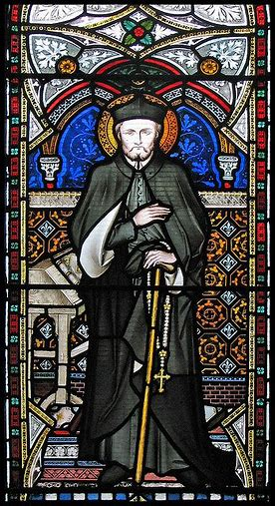
Who are our Confirmation program patron saints?
Our Lady of the Cenacle
  Pentecost
St. Philip Neri
    The patron saint of Confirmation
    The patron saint of joy

Slide 9
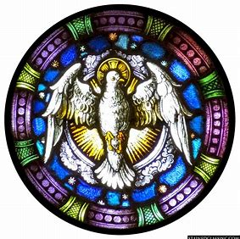
What is our Confirmation program timeline?
Monthly religious education classes: September 2024-May 2025
Choose a saint name (September 2024-April 2025)
  Selection due: Friday, April 11, 2025, by midnight
Choose a sponsor (September 2024-April 2025)
  Selection due: Friday, April 11, 2025, by midnight
Complete 15 hours of service to parish or local community (June 2024-May 2025)
  Submit reflection and service log: due Thursday, May 8, 2025
Confirmation rehearsal: target date Thursday, May 8, 2025
Mass of Confirmation: target date Saturday, May 10, 2025

Slide 10
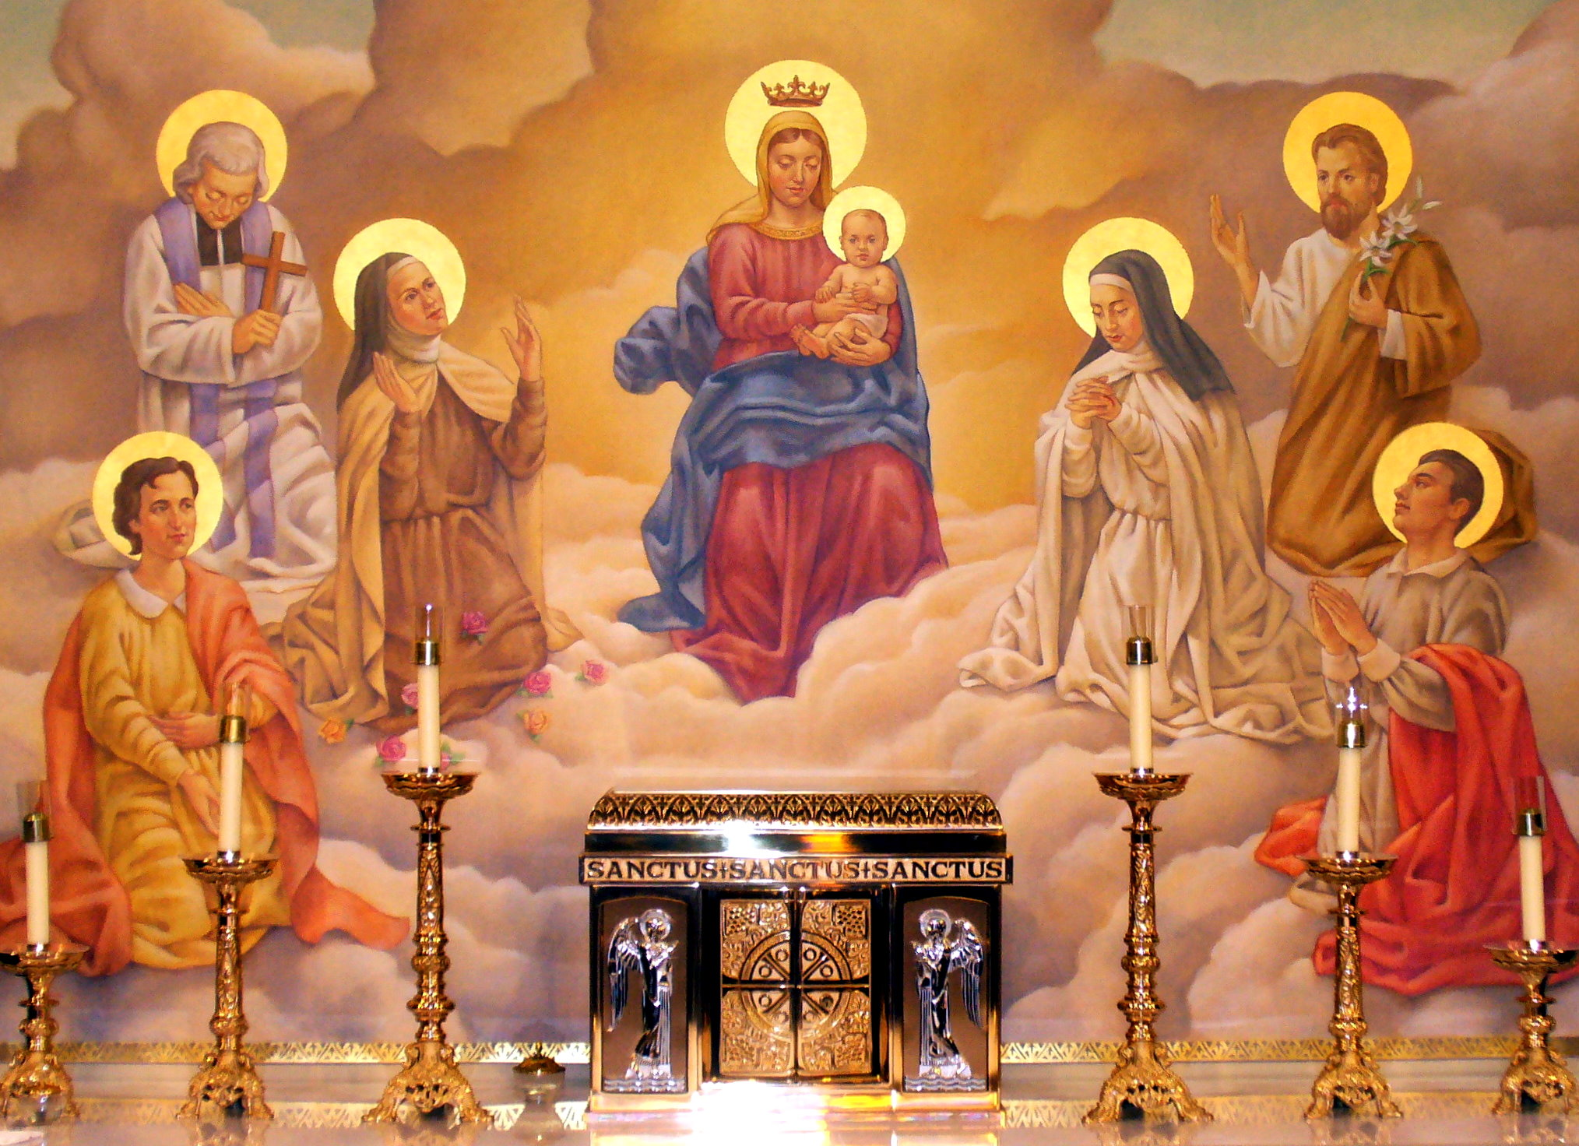
How does one choose a Confirmation patron saint?
Pray
Read about the lives of the saints
Choose a role model of Catholic life
Reflect and discern; keep a journal:
  Which saint do you personally relate to?
  Which saint has had similar life experiences to you?
  Which saint shares your vocation?
  Which saint had similar interests to you? Which special devotions did they practice, like you?
  Which saint do you especially admire, and would like to be like?

Slide 11
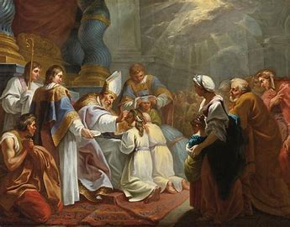
What considerations should one make when choosing a Confirmation sponsor?
Choose a role model
  What spiritual/personal qualities do you want to grow in?
  Who is a Catholic you greatly respect, and want to be like?
  Who inspires you with their faith?
Choose a friend of Christ
  Who loves Jesus, and can help you to become closer to Jesus?
  Who will be your friend in your spiritual journey to Confirmation and beyond?

Slide 12
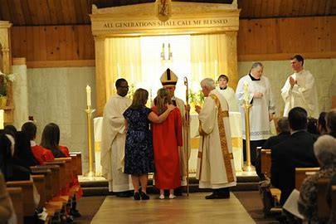
What conditions must one fulfill in order to serve as a Confirmation sponsor?
A Confirmation sponsor:
  Is a practicing Catholic
  Is at least 16 years old
  Is not the parent of the Confirmation candidate
  Has received the sacraments of initiation (Baptism, Holy Communion, Confirmation)
    If married, was married in the Church
  May be a godparent of the candidate (but is not a requirement)

Slide 13
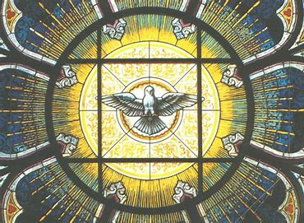
What resources are available to candidates in our Confirmation program?
Yearly lesson book
Catechism book on the Holy Spirit
Prayer cards
Confirmation information packet
Google Calendars
  Parish-wide
  Religious education-specific

Slide 14
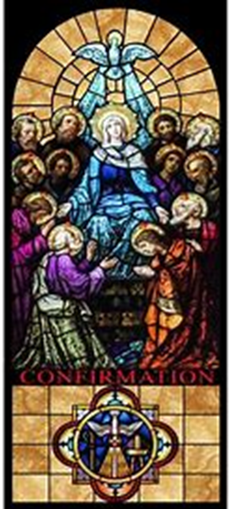
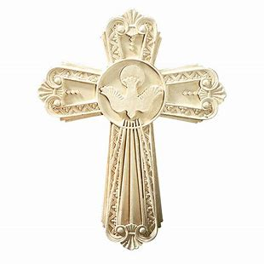
What further steps are recommended to prepare for Confirmation?
Sacrament scrapbook
Spiritual reading
Family prayer
Sacramental confession
Practice special liturgical devotions

Slide 15
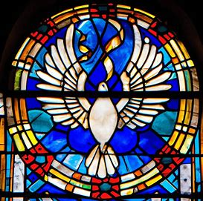
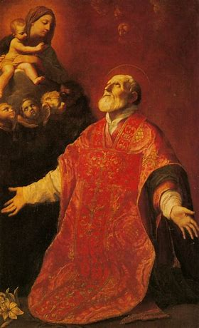
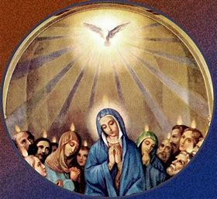
Closing Prayer: Prayer for the Intercession of St. Philip Neri
O Holy St. Philip Neri, patron saint of joy, you who trusted Scripture’s promise that the Lord is always at hand and that we need not have anxiety about anything, in your compassion heal our worries and sorrows and lift the burdens from our hearts.
We come to you as one whose heart swells with abundant love for God and all creation. Hear us, we pray, especially as we prepare our candidates to receive the sacrament of Confirmation.
Keep us safe through your loving intercession, and may the joy of the Holy Spirit which filled your heart, St. Philip, transform our lives and bring us peace. Amen.
Immaculate Heart of Mary,
pray for our Confirmation
students as they prepare to
open their hearts to the Holy
Spirit, as you did.
Keep our students, their family
members, and all in our parish
close to your heart. May we
grow in love for God,
your beloved, and use all He has
given us to serve Him.

Slide 16
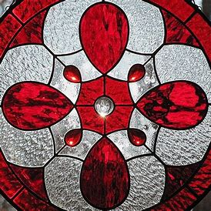
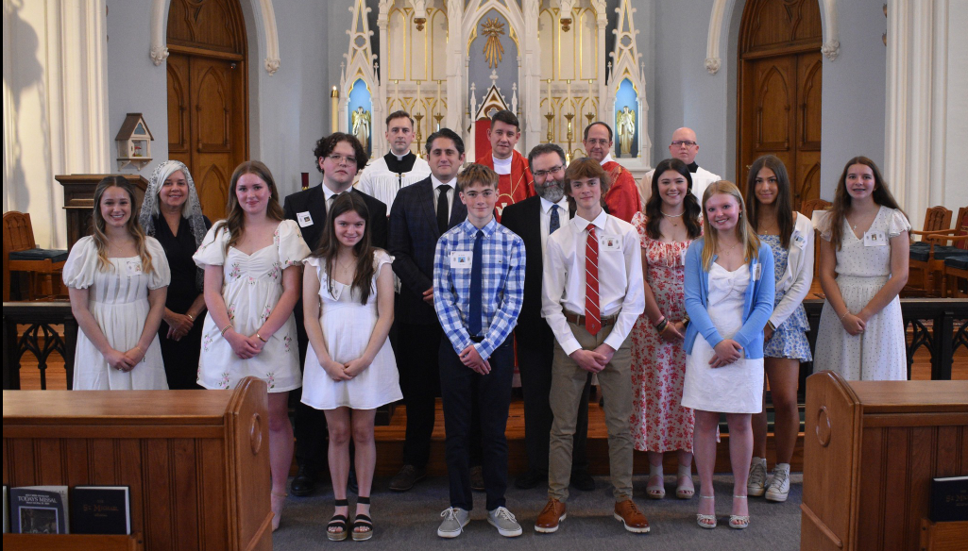
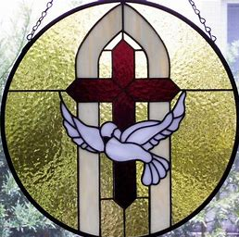
Our Lady of the Valley Parish 2024 Confirmation

