Slide 1
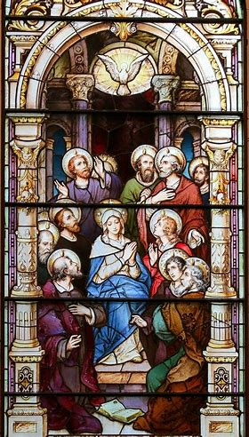

Catechist Welcome Meeting: REY 24-25
Saturday, August 24, 2024
Katie Sadakierski

Slide 2

Outline
Opening prayer
Overview
Closing prayer
Q & A / Meet and greet

Slide 3

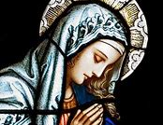
Opening Prayer: Hail Mary
Hail, Mary, full of grace,
The Lord is with thee;
Blessed art thou among women,
And blessed is the fruit of thy womb, Jesus.
Holy Mary, Mother of God,
Pray for us sinners,
Now and at the hour of our death. Amen.
St. Robert Bellarmine, pray for us.
Our Lady, Queen of All Saints, pray for us.

Slide 4

Overview of OLV
Rel. Ed. Program
Family catechesis
Monthly in-person meeting
  Learning centers
  Grades PK-12
Original learning materials
Sacrament preparation

Slide 5


Introduction: Curriculum
& Instruction
  Integrated curriculum (interdisciplinary)
  Classical/liberal arts: trivium
  PK-2: grammar (foundational knowledge)
  3-6: logic (building on foundational knowledge)
  7-9/10-12: rhetoric (application)

Slide 6
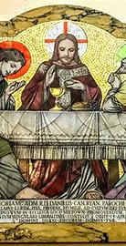
Rel. Ed. Program:
Goals and Objectives
Share God’s love joyfully
Preserve and revive tradition
Lead to Jesus, the Way, the Truth, and the Life
Honor God
Evangelize and catechize

Slide 7
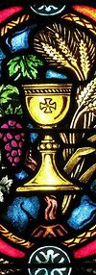
Initiatives Being
Offered this Year (1)
Summer learning for all ages
Expanded programming: children & adults
Sacrament preparation: expansion of learning resources

Slide 8
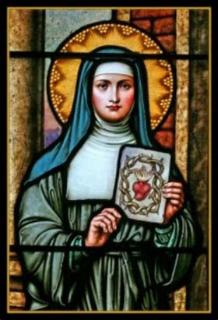
Initiatives Being
Offered this Year (2)
Supplementary activity books
Catholic devotions
Emphasis on saints: learning opportunities

Slide 9
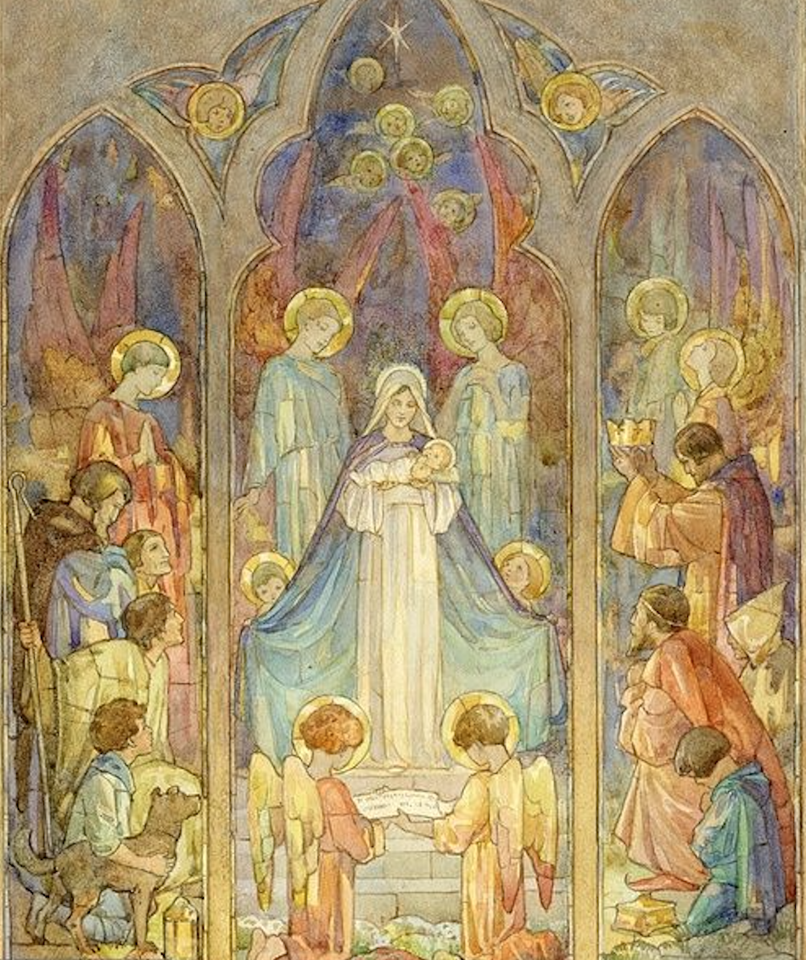
Opportunities for Volunteering in the Rel. Ed. Program
Catechist: lead catechist, mentor catechist
Aide
Hospitality volunteer

Slide 10

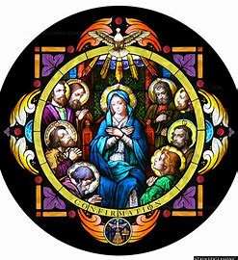
Opportunities for Volunteering in the Rel. Ed. Program
Photographer
Promoter: spreading awareness of our program
Religious education program event volunteer

Slide 11
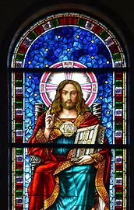
Overview of OLV Rel. Ed. Year 2024-25
Schedule
Class structure
Communications

Slide 12
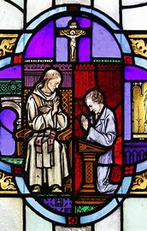
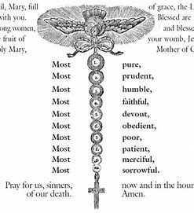
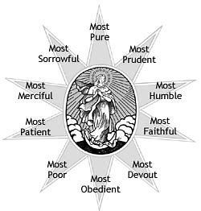
Resources for Catechists
Catechist handbook
Prayer cards
Parish website: catechist corner
Google Calendar
Mary, Mother of Catechists
Christ the Teacher

Slide 13
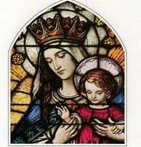
Upcoming Rel. Ed. Events (1)
Sacrament preparation program informational meetings:
  Thursday, September 5, 2024
  6:00 p.m., parish hall (First Holy Communion)
  7:00 p.m., parish hall (Confirmation)
Religious education class 1:
  Thursday, September 12, 2024
  6:00 p.m., parish hall; volunteers: arrive for 5:30 p.m.

Slide 14
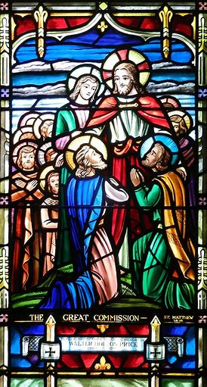
Upcoming Rel. Ed. Events (2)
Catechist workshop 1 session on Mother Teresa:
  Thursday, September 19, 2024
  6:00 p.m., parish hall
Religious education Mass:
  Friday, September 20, 2024
  6:00 p.m., church
  Blessing of parents, children, volunteers/catechists (commissioning prayers)
  Reception in parish hall (7:00 p.m.)

Slide 15
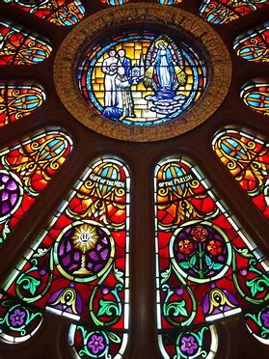

Closing Prayer:
Litany of the Holy Ghost
Holy Ghost, shed Thy light in our souls…
Holy Ghost, inflame us with the flame of Thy love.
Holy Ghost, open to us the treasures of Thy graces.
Holy Ghost, teach us to pray well.
Holy Ghost, enlighten us with Thy heavenly inspirations.
Holy Ghost, lead us in the way of salvation…
Holy Ghost, inspire in us the practice of good.
Holy Ghost, grant us the merits of all virtues…
Holy Ghost, be Thou our everlasting reward.
Lamb of God, Who takest away the sins of the world, Send us Thy Holy Ghost.
Lamb of God, Who takest away the sins of the world, pour down into our souls the gifts of the Holy Ghost.
Lamb of God, Who takest away the sins of the world, grant us the Spirit of wisdom and piety.
V. Come, Holy Ghost! Fill the hearts of Thy faithful,
R. And enkindle in them the fire of Thy love…
Amen.

Slide 16
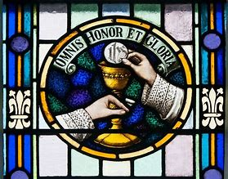
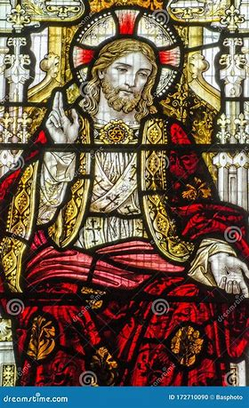


Before you go (and make disciples of all nations!)…
“Getting to Know You” page
Catechist/volunteer form
Additional printouts
  Folder
  Box of devotional materials

Slide 17
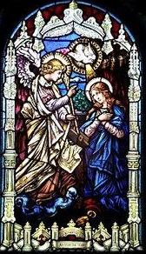
Q & A
I am open to feedback! Conversation and collaboration helps to strengthen our program.
Let’s combine our talents to make our religious education program the very best it can be!

