Slide 1


Class Session 3
November 16, 2023
Katie Sadakierski
Our Lady of the Valley

Slide 2



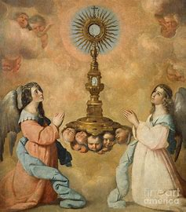

Class Outline
Opening prayer
Overview of monthly theme & activities
Learning centers
Announcements
Closing prayer
*Eucharistic Adoration:
Holy hour for vocations, 6-7 p.m.

Slide 3


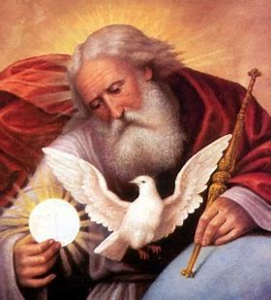
Opening Prayer: Our Father
Our Father,
Who art in Heaven,
Hallowed be Thy Name.
Thy Kingdom come.
Thy will be done on Earth, as it is in Heaven.
Give us this day our daily bread.
And forgive us our trespasses,
As we forgive those who trespass against us.
And lead us not into temptation,
But deliver us from evil.
Amen.

Slide 4

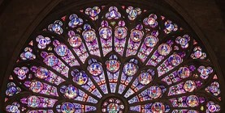
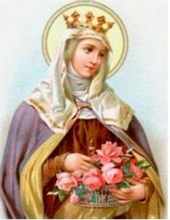
Overview of November
Saint of the month: St. Elizabeth of Hungary
  Ministering to people in need: giving bread to the poor,
  and teaching about Jesus, the Bread of Life
Thanksgiving
  A holiday for gathering with family and friends
“Eucharist” means “thanksgiving”: we are grateful for blessings God gives us
  At Mass & Adoration, we gather as a Church family to adore Jesus
  God feeds our souls through the Eucharist. Prayer and the sacraments sustain us
  We help to feed the souls of others through
  sharing God’s love with them

Slide 5



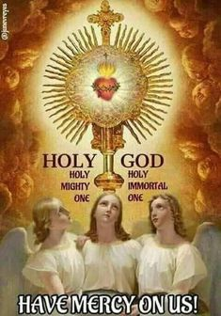
PK-2
Week 1: Praying the Mass as a Church family;
souls on Earth, in Purgatory, and in Heaven
Week 2: Thanking God for His goodness;
saying grace and praying as a family when we share meals
Week 3: St. Elizabeth; being like the saints
and sharing God’s blessings
Tonight’s learning center (parish hall): Making art depicting the monstrance;
the beauty of Mass and Adoration; honoring Jesus’ Eucharistic Presence

Slide 6



3-6
Week 1: Heaven, the saints, and sacramentals (medals)
Week 2: Being merciful like the saints (St. Elizabeth);
Jesus’ miracles (“Feeding of the Multitudes”); the Bread of Heaven
Week 3: The Mass; praising God through sacred music;
prayers of thanksgiving
Tonight’s learning center (parish hall): Giving our thanks to God-
Bible scavenger hunt, Scriptures on the Eucharist, and gratitude activity

Slide 7
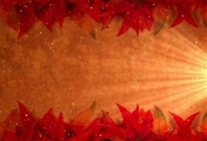

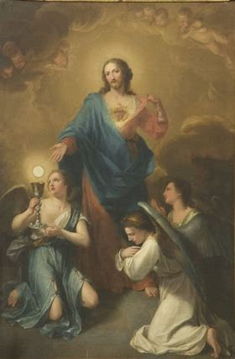
7-9
Week 1: Praying for the Holy Souls; the sacraments and salvation;
finding balance and hope in life through Christ
Week 2: Keeping gratitude journals; prayers of thanksgiving
Week 3: sharing our thanks for God; working together as One
Church to bring Christ into the world
Tonight’s learning center:
Presentation on vocations (parish library);
holy hour for vocations (Exposition,
Eucharistic Adoration, Benediction in the church)

Slide 8
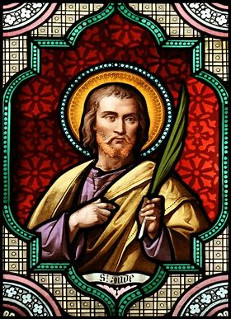
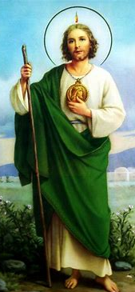
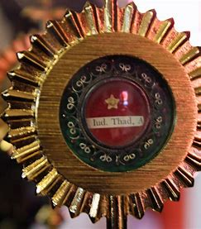
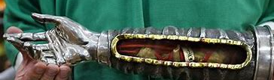
Announcements
St. Jude relic traveling to St. Thomas the Apostle Church,
West Springfield, MA
  Friday, November 17, 2023: public veneration begins at 2:30 p.m.
    Mass at 7:00 p.m.
    Veneration of relic continues until 10:00 p.m.

Slide 9

Announcements 2
Service opportunity (Confirmation/Pre-Confirmation; families):
  Take & Eat ministry
    Sign and address Thanksgiving cards to be sent to people in need with meal deliveries
    Saturday, November 18, 2023: morning (~9-10 a.m.)
      Contact coordinator Lisa York by email: ljyork37@gmail.com
Next religious education class session:
  Thursday, December 14, 2023
    6:00 p.m.
    Parish hall

Slide 10


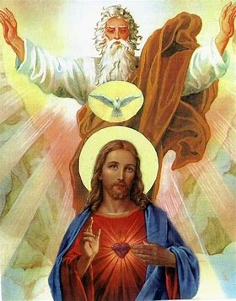

Closing Prayer: Glory Be
Glory be to the Father,
And to the Son,
And to the Holy Spirit.
As it was in the beginning, is now,
And ever shall be,
World without end. Amen.

