Slide 1

Class Session 2
October 26, 2023
Katie Sadakierski
Our Lady of the Valley

Slide 2

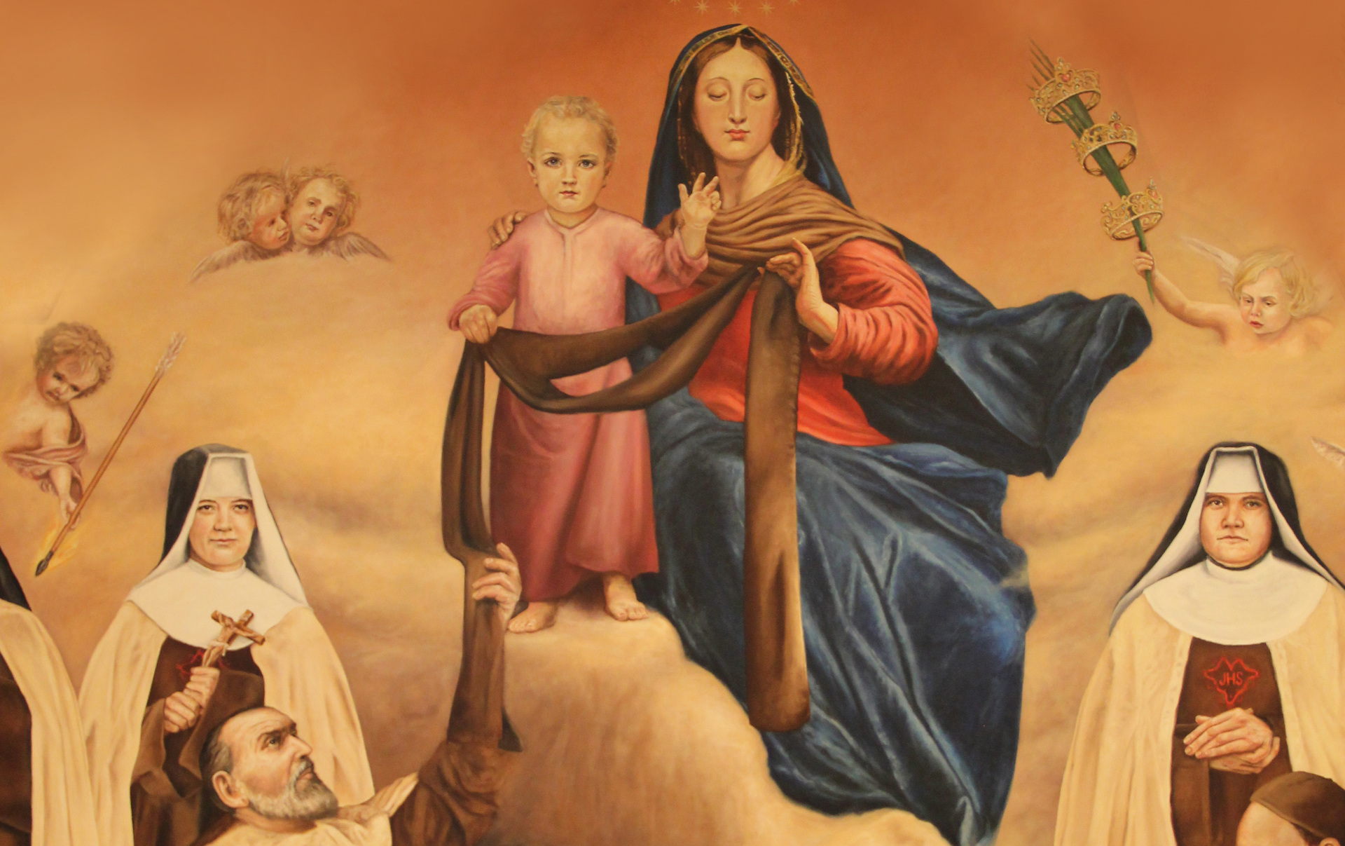

Class Outline
Opening prayer
Overview: Monthly activities
Learning centers
Announcements
Closing Prayer
Scapular investiture (church)

Slide 3

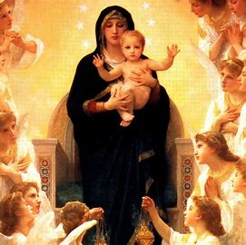
Opening Prayer
Remember, O most gracious Virgin Mary, that never was it known
that anyone who fled to thy protection, implored thy help,
or sought thy intercession, was left unaided.
Inspired by this confidence, I fly unto thee,
O Virgin of virgins, my Mother;
to thee do I come, before thee I stand, sinful and sorrowful.
O Mother of the Word Incarnate, despise not my petition,
but in thy mercy, hear and answer me. Amen.

Slide 4

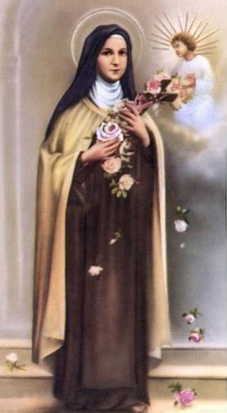
Recap of October 2023
Saint spotlight: St. Therese of Lisieux
  The Rosary; “Good deed beads”
Theme: Month of the Holy Rosary
  Feast of the Holy Rosary: October 7
  The Rosary is a gift from Our Lady
  Praying the Rosary is a gift to Our Lady

Slide 5
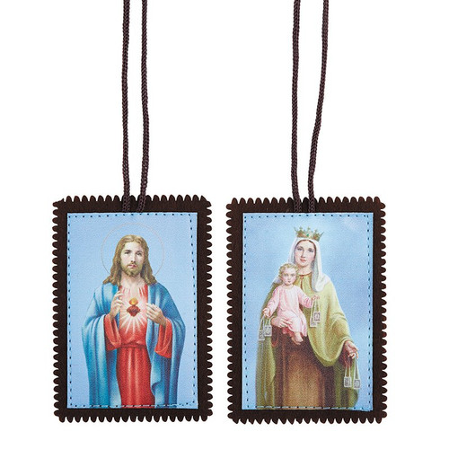
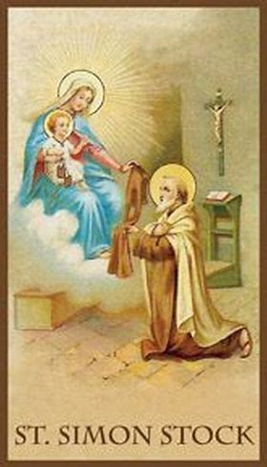
Overview of November
Theme: Month of the Holy Souls
  All Saints Day (November 1) and All Souls Day (November 2)
  The saints are friends of Jesus
  The saints are our friends in Heaven
    We pray for the souls in Purgatory awaiting Heaven; soon-to-be saints
    We are called to become saints, too. The saints help us to become saints, too
    Our Lady, the greatest saint, leads people to Heaven through the Rosary and the scapular; special blessings

Slide 6
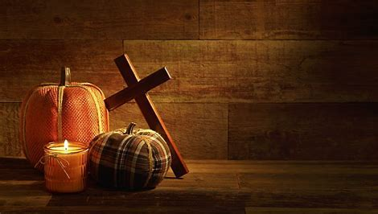
PK-2
Week 1: St. Therese, the Rosary, and the Mass
Week 2: Forming habits of holiness; praying chaplets; preparing for Confession & Communion
Week 3: St. Francis & caring for God’s creation; All Saints Day (making “saint-o-lanterns”)
Tonight’s learning center (parish hall): The brown scapular; making scapular wall hangings

Slide 7


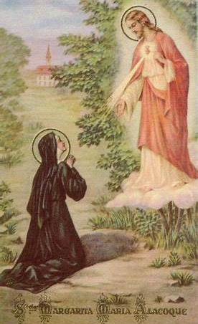
3-6
Week 1: St. Francis, building up the Church; using sacramentals in prayer (the Rosary)
Week 2: St. Margaret Mary; becoming close to the Sacred Heart of Jesus through the Rosary; places of prayer/shrines
Week 3: Helping others in our Church, living like the saints, enthroning Christ the King (feast day Oct. 29)
Tonight’s learning center: Stories of the saints & making Heavenly Hall of Fame plaques (parish library)

Slide 8



7-9
Week 1: The Rosary; the power of prayer; praying like Our Lady
Week 2: Devotions of St. Therese & St. Margaret Mary; praying the Rosary to honor Christ the King
Week 3: The Rosary and the Eucharist; growing in and applying the Gifts of the Holy Spirit; forming a heart like Christ’s (Sacred Heart of Jesus)
Tonight’s learning center: Ministry fair (parish hall)

Slide 9


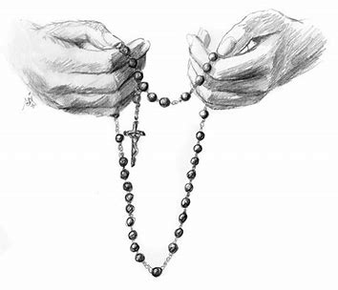
Announcements
OLV totes & mugs available
Upcoming dates:
  All Saints Day Mass: November 1, holy day
    12:00 p.m. (Latin)
    6:00 p.m.
Next class: Thursday, November 16, 2023, 6:00 p.m., parish hall

Slide 10

Announcements 2
  Reminder: Parish service opportunity
    Families
    Pre-Confirmation/Confirmation (grades 7-9)
      Church pew cleaning project
      Hours flexible; may be on weekday evenings (besides Wednesday), or on Saturdays (late mornings/afternoons)
      Contact: Gail Poulin
        poulingail@gmail.com

Slide 11



Closing Prayer: Hail Mary
Hail, Mary, full of grace,
The Lord is with thee;
Blessed art thou among women,
And blessed is the fruit of thy womb, Jesus.
Holy Mary, Mother of God,
Pray for us sinners,
Now and at the hour of our death. Amen.

