Slide 1


Class Session 1
September 21, 2023
Katie Sadakierski
Our Lady of the Valley

Slide 2
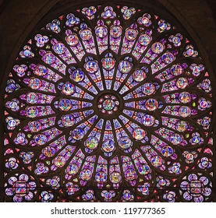
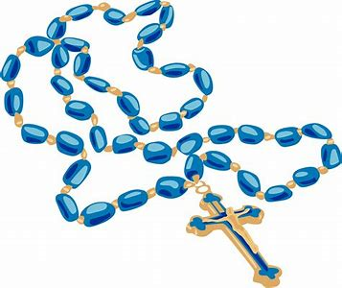
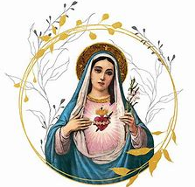
Class Outline
Opening prayer
Overview of monthly activities
Learning centers
Announcements
Closing prayer

Slide 3

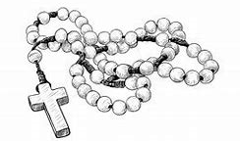
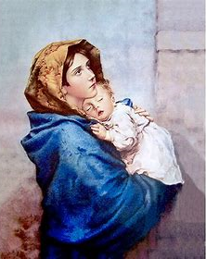
Opening Prayer
Hail Mary/Angelic Salutation (Ave Maria)
Hail, Mary, full of grace,
The Lord is with thee;
Blessed art thou among women,
And blessed is the fruit of thy womb, Jesus.
Holy Mary, Mother of God,
Pray for us sinners,
Now and at the hour of our death. Amen.

Slide 4



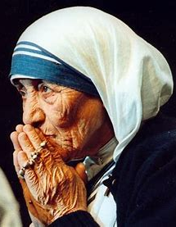
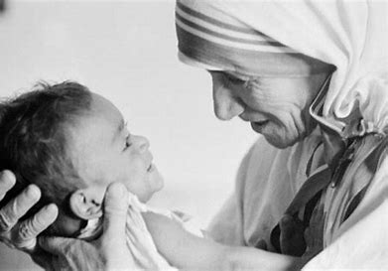
Overview of September
Saint of the month: St. Teresa of Calcutta
September theme: birthday of Mother Mary & the Rosary

Slide 5

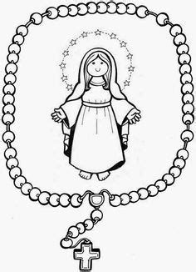
Grades PK-2: Pre-First Communion & First Communion
Week 1: Celebrating Mother Mary’s birthday
Week 2: Celebrating Mother Mary’s Holy Name &
the angels; songs in the Church
Week 3: Priesthood Sunday, learning about priests in the Church
Tonight’s learning center: Learning the parts of the Rosary & making rosaries; praying for Mother Mary’s intercession to prepare for First Communion

Slide 6


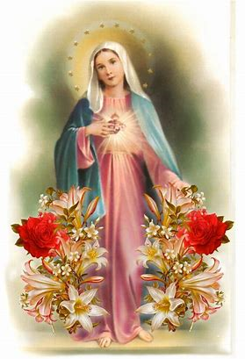
Grades 3-6
Week 1: Mother Mary’s birthday: gifts from Mother Mary
(the Rosary and scapular)
Week 2: Mother Mary’s Holy Name: Marian prayers
Week 3: Priesthood Sunday; prayers in the Church/liturgy of the
hours, how we use our talents to serve Jesus
Tonight’s learning center: The Mysteries of the Rosary, how to pray the Rosary, and making rosaries

Slide 7
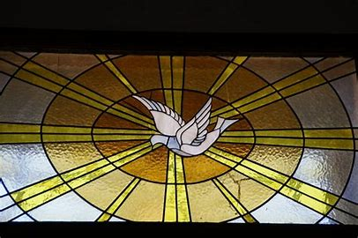
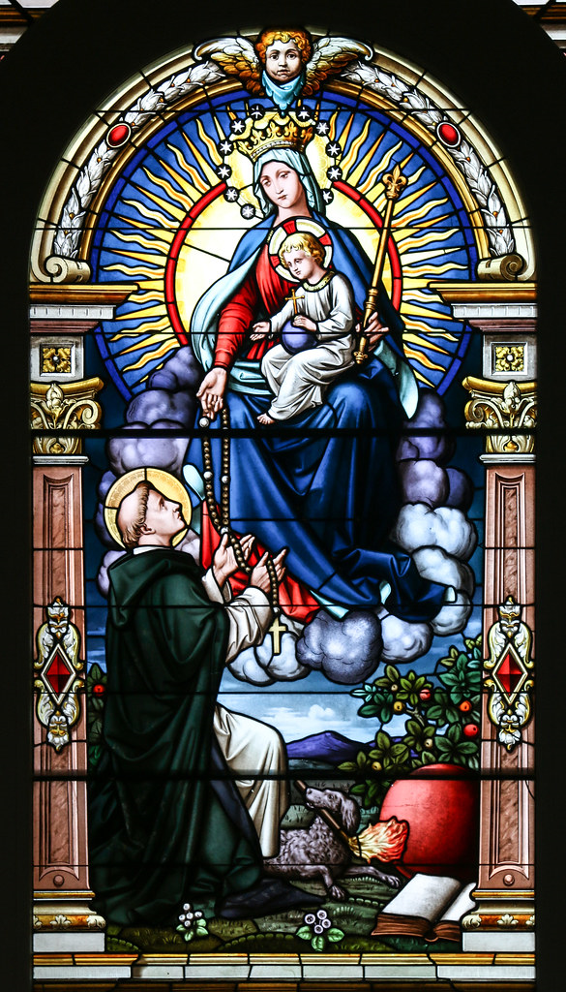
Grades 7-9: Pre-Confirmation & Confirmation
Week 1: Mother Mary’s birthday &
how we use our gifts from God
Week 2: Ministries in the Church, how Mother Teresa
lived out her ministry
Week 3: Praying to know our vocations
Tonight’s learning center: Art in the church & understanding the Mysteries of the Rosary, praying the Rosary to prepare for Confirmation; prayer journaling

Slide 8

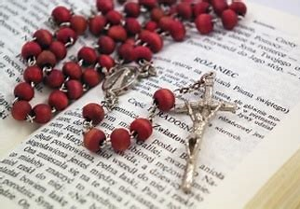
Announcements: Parish-Wide, All Grades
Mass for the Feast of the Archangels: September 29, 6:00 p.m.
Bibles still available; sign-up sheet on back table
Next class meeting: Thursday, October 26, 2023; 6:00 p.m. in the parish hall
  Bring prayer cards
  Grades 7-9: bring prayer journals

Slide 9


Announcements: Sacramental Preparation
Pre-Confirmation/Confirmation service opportunity
  Grades 7-9: church pew cleaning service project
  Flexible hours; weekday evenings or Saturdays
  Contact: Gail Poulin
    Email- poulingail@gmail.com

Slide 10

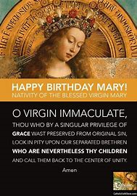
Closing Prayer
Hail, Holy Queen, Mother of mercy. Hail, our life, our sweetness, and our hope.
To thee do we cry, poor banished children of Eve. To thee do we send up our sighs, mourning and weeping in this valley of tears.
Turn then, most gracious Advocate, thine eyes of mercy towards us.
And after this our exile, show unto us the blessed fruit of thy womb, Jesus.
O clement, O loving, O sweet Virgin Mary.
Pray for us, O Holy Mother of God. That we may be made worthy of the promises of Christ.

