Slide 1
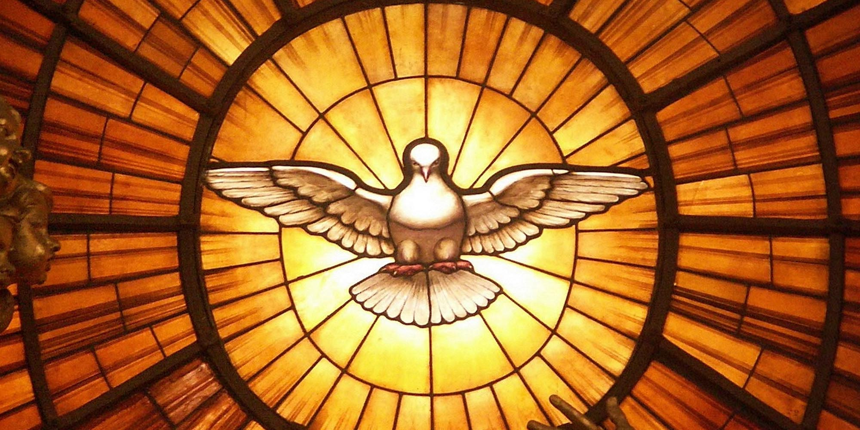

Confirmation
Katie Sadakierski
Our Lady of the Valley

Slide 2



~Meeting Outline~
Overview of the sacrament of Confirmation
Overview of sacramental preparation program
  Sponsors
  Saint names
  Service
  Retreat
  Monthly meetings and activities

Slide 3

~Opening Prayer~
Come, Holy Ghost, fill the hearts of Thy faithful and kindle in them the fire of Thy love.
Send forth Thy spirit, and they shall be created.
And Thou shalt renew the face of the earth.
Let us pray: O God, Who hast taught the hearts of the faithful by the light of the Holy Ghost, grant that by the gift of the same Spirit we may be always truly wise and ever rejoice in His consolation. Through Christ our Lord. Amen.

Slide 4

~What is Confirmation?~
One of the seven sacraments
Gifts of the Holy Spirit
Special graces
  Fuller outpouring of graces from Baptism
  Keeping baptismal promises to God
  Spiritual growth, strengthening
  A new beginning to faith journey

Slide 5
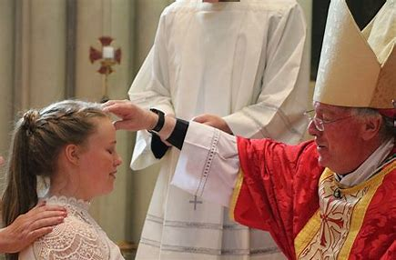
~What happens at Confirmation?~
Renewal of baptismal promises
Presentation of the candidates
  Announce saint name
Anointing with chrism oil
  To be set apart
  Made a soldier of Christ for life
    Connection to sacraments: Baptism, Eucharist, Holy Orders
  Mark on the soul
  Sealed with the Gifts of the Holy Spirit

Slide 6

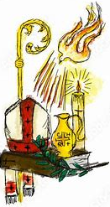
~What will I need to be confirmed?~
Diocese: grade 9
Sponsor
Right disposition
Sacrament preparation
  Engagement with learning materials
  Service
  Saint name

Slide 7


~What is included in the Confirmation packet?~
Timeline, target deadlines for form submissions
FAQs, links to resources
Glossary
Prayers
Confirmation service hour ideas
Parish directory for service opportunities within organizations
Sponsor selection guidelines and forms
Saint name selection guidelines and forms
Saint name ideas and quiz
Guidelines for Confirmation attire
Checklist

Slide 8
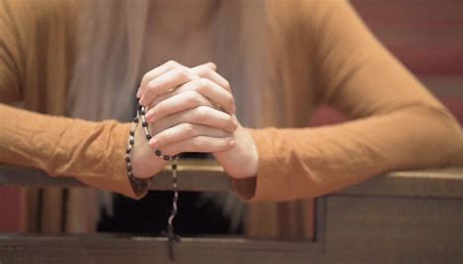

~Monthly Meetings & Activities~
Rel. ed. monthly meetings
  September-May
  Confirmation retreat and rehearsal
Monthly activity packets within book for year
  Available online as individual packets as well
  Grade 9: Confirmation-related activities
    Lessons on the sacrament, applications for life

Slide 9

~Confirmation Timeline: Part 1~
Pray to the Holy Spirit before any work
September-October 2023
  Take saint quiz, make list of possible saints to research, brainstorm sponsors, list service opportunities of interest
November-December 2023
  Continue researching saints, reach out to potential sponsors, reach out to service organizations

Slide 10

~Confirmation Timeline: Part 2~
January-February 2024
  Continue working on service hours, saint research
March-April 2024
  Submit saint name choice
  Submit sponsor form,
  Finalize service hours, submit log and reflection

Slide 11
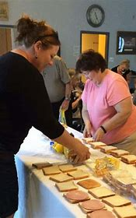

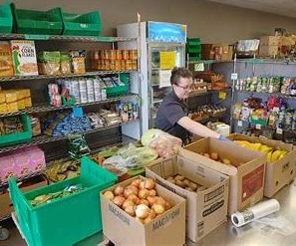
~Confirmation Service~
10 hours
Parish or local community
  Parish & local service directory
Service log
Service reflection
Gifts of the Holy Spirit
Mission, calling

Slide 12
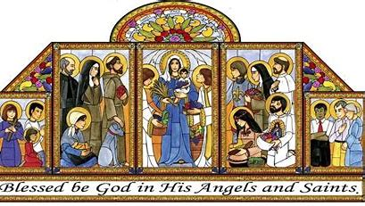
~Confirmation Saint Names~
Saint name choice guides
  Meanings of names
    Link to Baptism
  Patronage
Saint name quiz

Slide 13
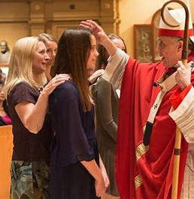
~Confirmation Sponsors~
At least 16 years old
Has received the sacraments of initiation
  Baptism, Confirmation, Eucharist
A practicing Catholic
If married, married in the Church
Not a parent of the Confirmation candidate
A role model in living out the Faith
If member of another parish: pastor signature

Slide 14

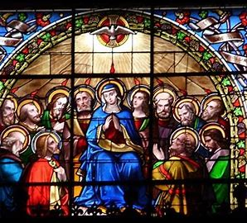
~Confirmation Retreat~
Retreat at the parish
Speakers
Prayer
Reflection
Banners

Slide 15
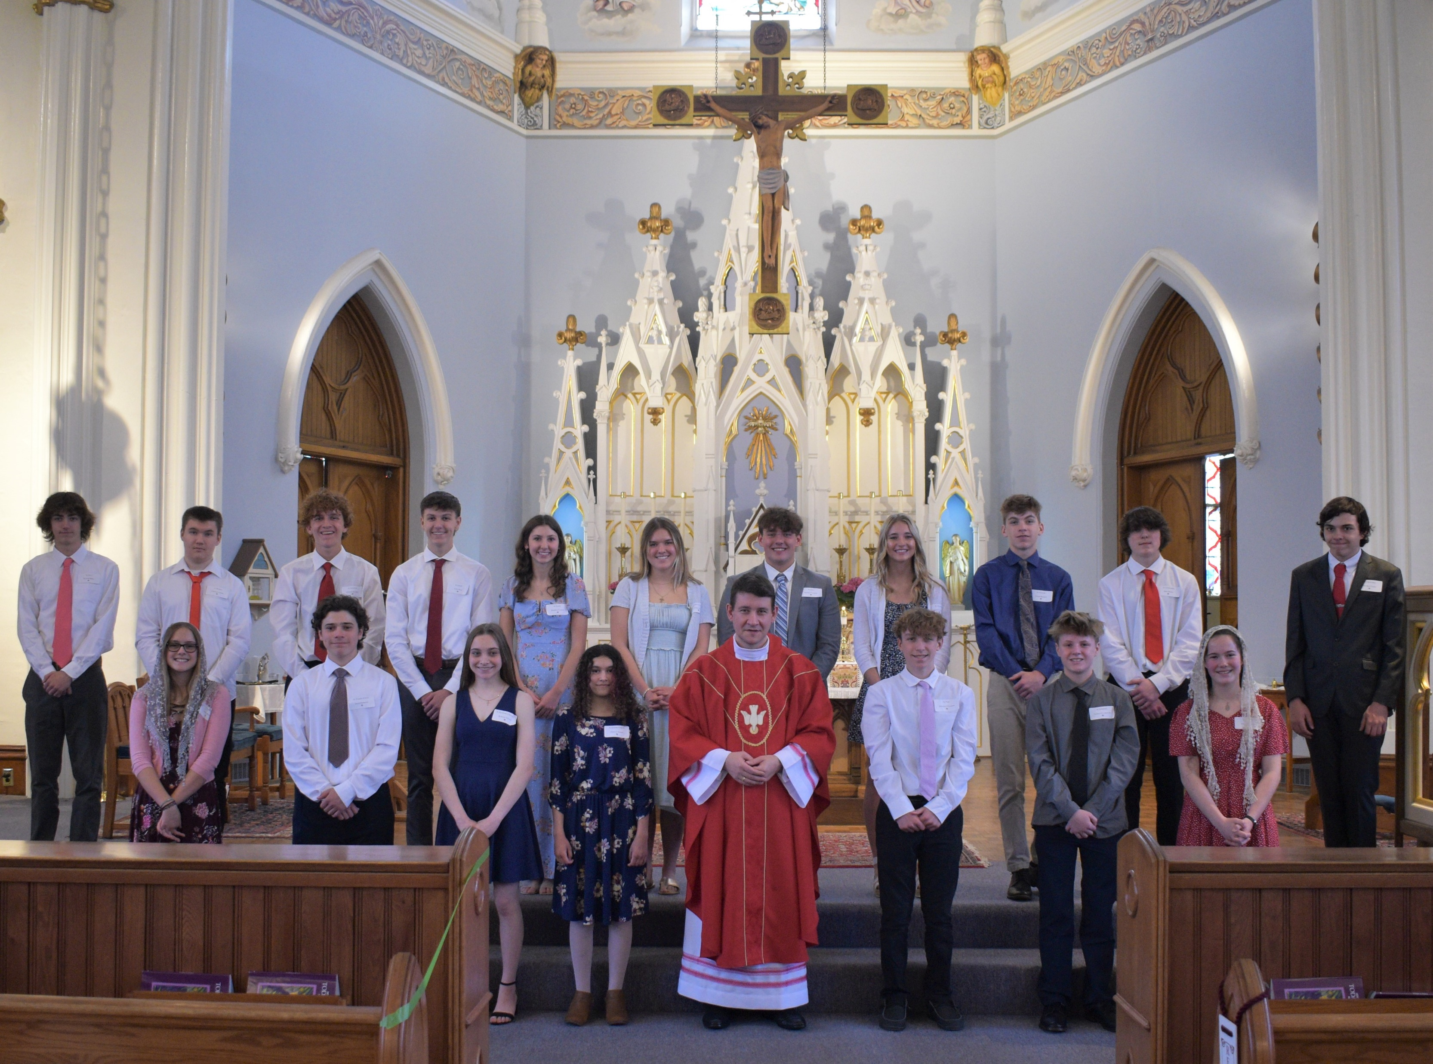

Slide 16


~Closing Prayer~

