Slide 1


Class Session 3: February 16, 2023
Katie Sadakierski
Our Lady of the Valley

Slide 2
Welcome & Introduction
Class Outline
  Prayer
  Sharing with group
  Overview
  Panel on prayer, breakout sessions, discussion
  News, updates, questions

Slide 3
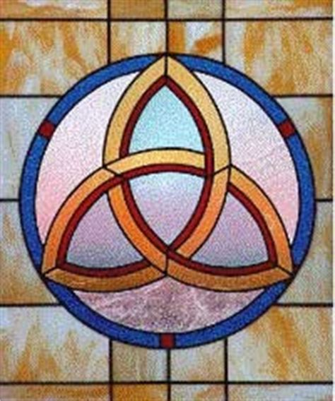
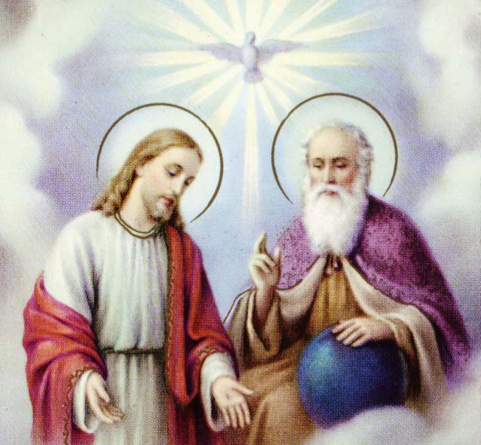
Opening Prayer: Glory Be
Glory be to the Father,
And to the Son, and to the Holy Spirit,
As it was in the beginning,
Is now, and ever shall be,
World without end,
Amen.

Slide 4
February Theme & Review
Love (charity)
Monthly challenge: Lent preparation, showing love to God and others
  How did you live out the theme this month, engage with the challenge?
  What did you learn through this experience?
  Confirmation: what have you been learning from your experiences with serving the church and community so far?

Slide 5

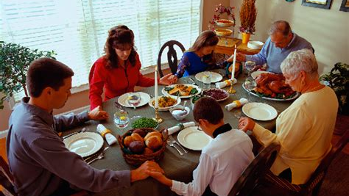

Preview of Month Ahead
March: Patience

Slide 6

March: Week 1
PK-2: Celtic crosses, Bible stories, Lenten traditions
3-6: Patience and building community, the
Cross, symbols of the Holy Trinity
7-12: art, signs & symbols of sacraments (Confirmation),
symbols of the Holy Trinity

Slide 7


March: Week 2
PK-2: St. Patrick, three-leaf clovers, the Holy Trinity
3-6: St. Patrick’s Day, Holy Trinity, sacraments, signs and
symbols in art
7-12: Our Lady of Knock (Ireland), St. Patrick
and the Holy Trinity

Slide 8

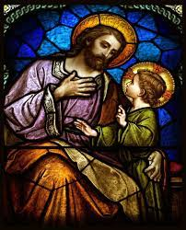
March: Week 3
PK-2: God’s love and patience in the sacraments,
St. Joseph’s Day traditions
3-6: St. Joseph’s Day traditions, the Annunciation,
Beatitudes
7-12: Patience like the saints: St. Joseph and Mother
Mary, God’s plan

Slide 9

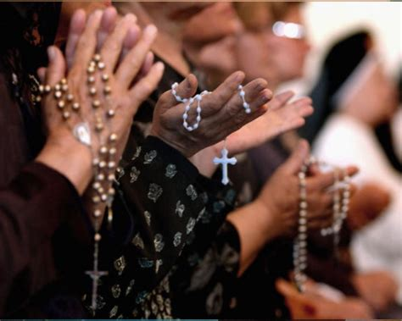

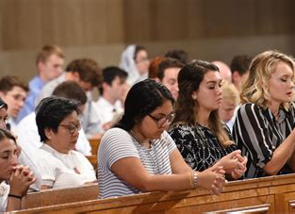
March Kickoff: Panel on Prayer
What is your favorite prayer, or favorite form of prayer?
How have you experienced the power of prayer?

Slide 10
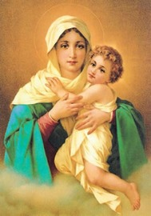
Memorare
Remember, O most gracious Virgin Mary,
that never was it known that anyone who fled to Thy protection,
implored Thy help, or sought Thine intercession, was left unaided.
Inspired by this confidence, I fly unto Thee,
O Virgin of virgins, my Mother.
To Thee do I come, before Thee I stand, sinful and sorrowful.
O Mother of the Word Incarnate, despise not my petitions,
but in Thy mercy, hear and answer me.
Amen.

Slide 11
Sacramental Preparation News & Notes
First Confession rehearsal: March 30 in church (meet in parish hall first, 6:00 p.m.)
  First Confession: Thursday, April 20, 2023
    An alternative (make-up) date: Sunday, April 2, 4:00 p.m.
Dress code guidelines for Confirmation and First Communion
Service reminders/ongoing opportunities:
  Take & Eat sandwich ministry: to volunteer, contact Lisa York (email ljyork37@gmail.com, or call 413-626-8837. You may also call the rectory at 413-527-9778)

Slide 12
News & Updates
Bibles
Pastor installation: Saturday, February 18, 2023, 4:00 p.m. Mass
Eucharistic Congress: Saturday, March 4, 2023, MassMutual Center in Springfield: https://catholiclifeconference.org/
  Contact Chris Wodecki for more information: phone- (413) 527-9778 x 130, email- wodecki.olv@gmail.com
Next class meeting: March 30, 2023

Slide 13
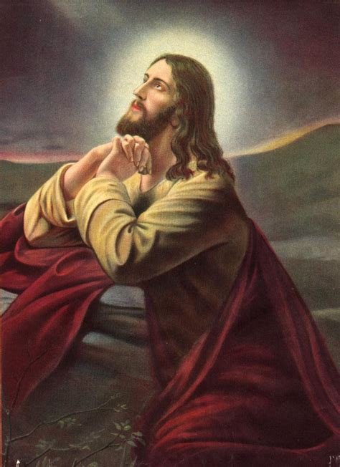
Closing Prayer

