Slide 1


Class Session 2: January 26, 2023
Katie Sadakierski
Our Lady of the Valley

Slide 2
Welcome & Introduction
Class Outline:
  Sharing
  Overview
  Saint panel & discussion
  Updates, questions
Activity completion
  Collection and feedback

Slide 3
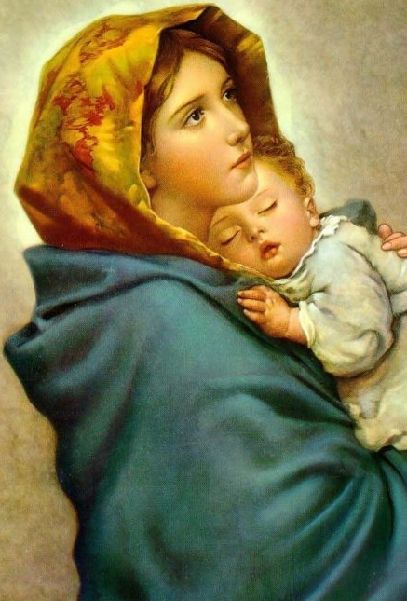
Opening Prayer: Hail Mary
Hail Mary, full of grace,
the Lord is with thee:
Blessed art thou among women
and blessed is the fruit of thy womb, Jesus.
Holy Mary, Mother of God, pray for us sinners,
now, and at the hour of our death. Amen.

Slide 4
Sharing
What did you do for your December challenge to spread joy?
What did you learn from this experience?
How did it make you feel to bring joy?

Slide 5

February Theme & Review
Theme: Charity (Love)
Monthly challenge: Prepare for Lent, starting on Ash Wednesday, February 22, 2023, by deciding how you can show love to God and others either through sacrificing something for Lent, or adding something, like a daily Rosary or reading of a Bible passage, for spiritual development

Slide 6


Week 1
PK-2: Loving our families, loving God, Candlemas, loving the Eucharist (First Communion)
3-6: The Cross, Jesus’ love for us, Candlemas, Lent
7-12: February feast days, Church traditions
  First Friday, Candlemas, and sacred art

Slide 7
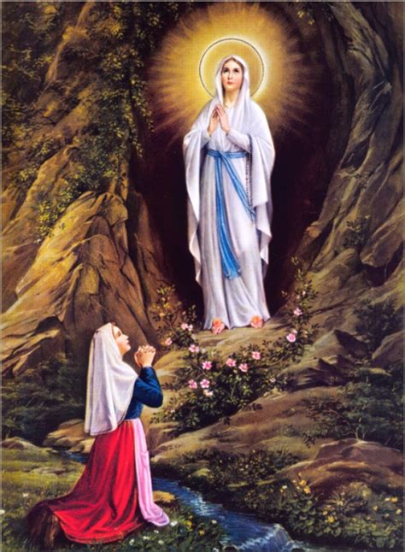
Week 2
PK-2: Loving our Church, God’s love in our Church, love for God at Lent and throughout the year
3-6: Theological virtues, Lenten resolutions, Our Lady of Lourdes, writing prayers
7-12: The meaning of Lent, God’s love for us, and the sacraments
  Reflection journals: how we practice living out love for God

Slide 8

Week 3
PK-2: Love of the Cross, saint valentines, God’s love and forgiveness (First Confession)
3-6: Saint valentines, reflection journals
7-12: Sacred music, making saint valentines

Slide 9
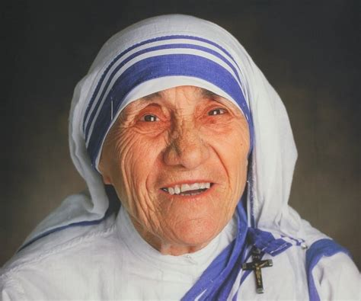
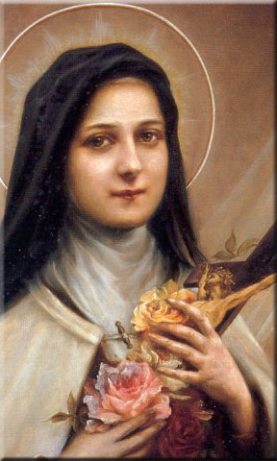
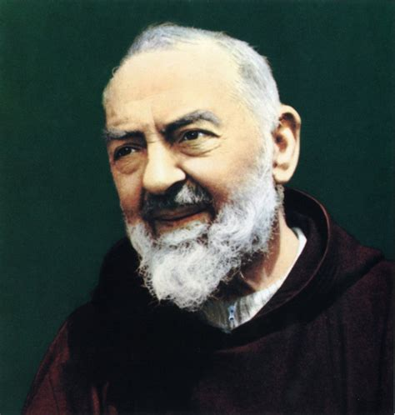
February Kickoff
  Preparing for Lent
  Favorite saints
    What do we love about the saints?
    How did they show their love God?
    Which saints can you look to as “holy helpers” to guide you during Lent? Which saint can be a role model for you in living out your love for God?

Slide 10
Sacramental Preparation Notes
  First Confession rehearsal
    March 30 class
  Confirmation: service, forms
    Website, Google Forms: https://olveasthampton.org/religious-education/
    Email

Slide 11
Additional Notes & Reminders
Bibles
Tutoring schedule
  Website
  Email
  Bulletin
Pastor installation Mass
  Saturday, February 18, 2023, 4:00 p.m.

Slide 12
Additional Notes & Reminders Cont.
Next meeting: February 16, 2023
  Activity submission
    Online (email, form)
    In-person

Slide 13
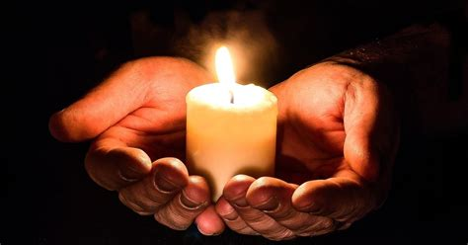
Closing Prayer

